Slide 1

Easy Deploy
Front end GUI for PsExec, A fast and easy remote deployment utility.

Slide 2
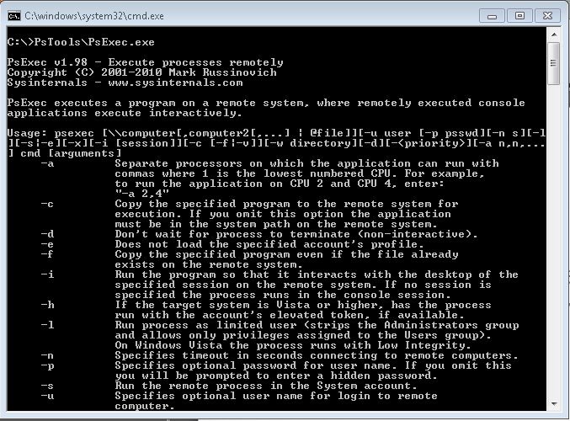
What is PsExec?
Robust command line utility used to remotely execute processes on Windows based machines. Part of the PsTools Suite. Designed by Mark Russinovich.

Slide 3
About Easy Deploy
Makes use of PsExec more efficient. (Speed)
Packages several tools into one to process PsExec Commands. (Modular)
Takes care of all the leg work for you. (Easy)
Computer list building
Command building
Command Execution
Etc.
Requires .Net 4.0 framework.

Slide 4
How it works?
Easy Deploy
GUI
Managed Use of PsExec Process Management
PsExec
Command Line
Connectivity Authentication Remote Process Execution

Slide 5
Features
Custom Computer List Building
Redirected Output Capture (Reports)
Process Manager
Debug Options

Slide 6

Computer Lists
DNS Query (IP Scanner)
List Builder Tool
Active Directory
Open/Save Lists

Slide 7
Computer Lists Demo

Slide 8

Output Reports
Output Redirection
Process Start Reporting
MSI Success Reports
Raw PsExec Output

Slide 9
Process Reports Window

Slide 10
Process Manager
Processing Thread
Processing Begins when the Deploy button is Clicked.
PC List (Queue) ^
Command 2
Command 3
Command 4
Command 5 Command 6 Command 7 Command 8 Command 9
Command 10
^
.
.
Execute Command
Wait for Local Process to Finish*
Record Output

Slide 11
Debug Options
Show Process Window
Stop DNS Query
Stop All Processing
Stop Current Process
Stop PsExec.exe
Stop

Slide 12
Live Demo

Slide 13
Tips
When deploying some raw commands, the app sometimes hangs and requires a manual abort.
For best results, place executable on a shared folder that is accessible by everyone.
Use don’t wait for each process flag.
Click Deploy to check for missing parameters.
Use batch files that run autonomous executables.

